Slide 1
Vendor C-CDA to FHIR mapping review and alignment

Slide 2
Allergy

Slide 3
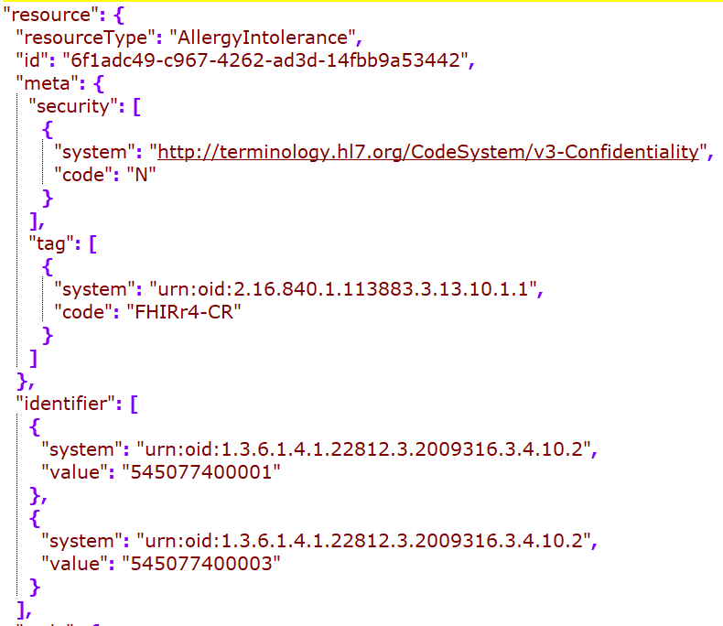
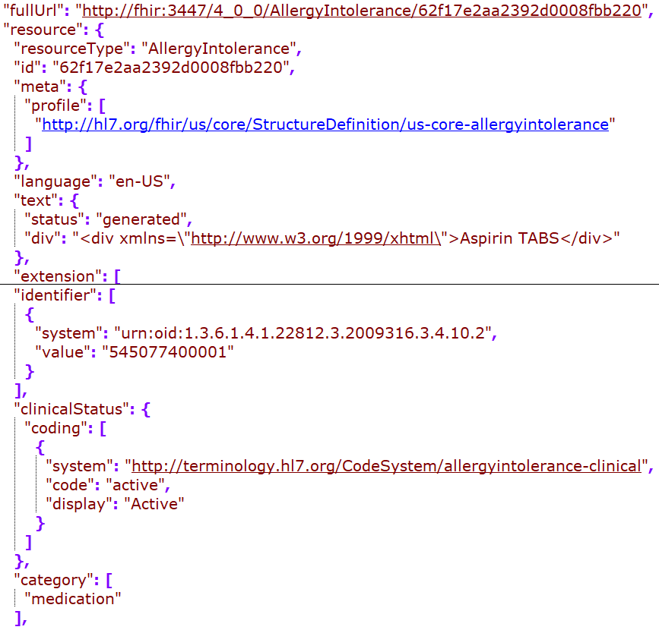
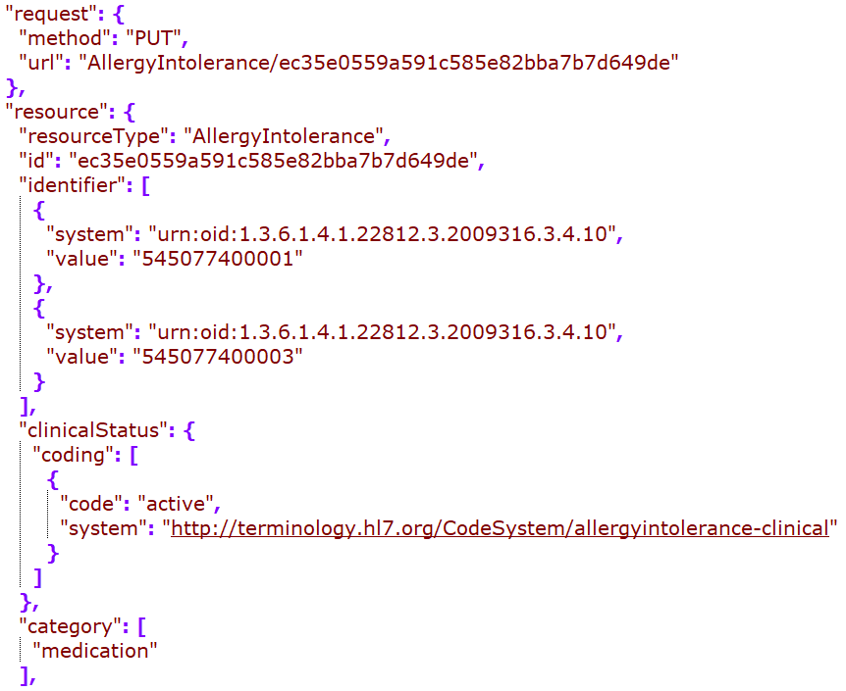
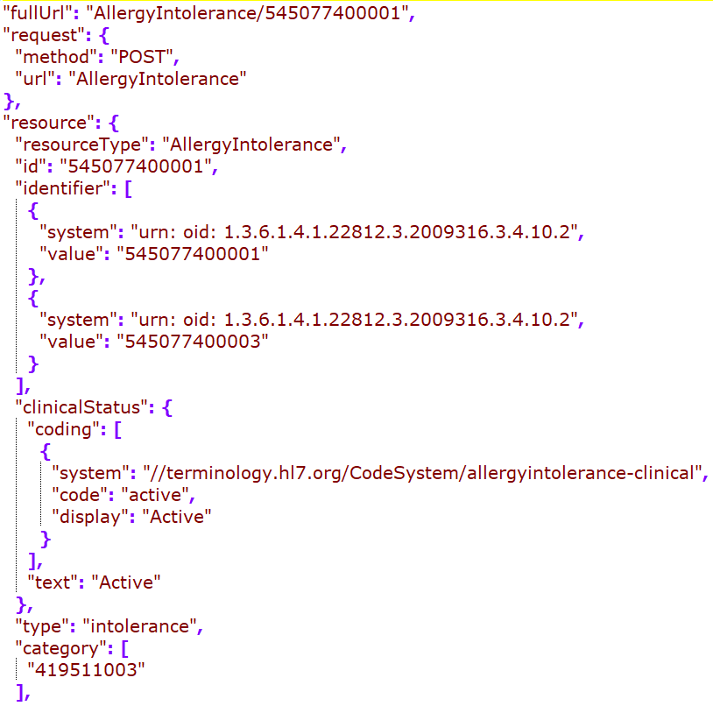
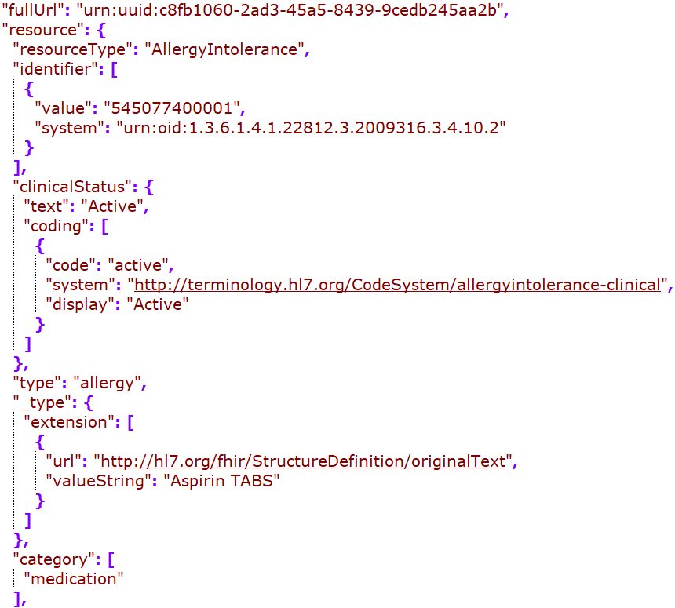
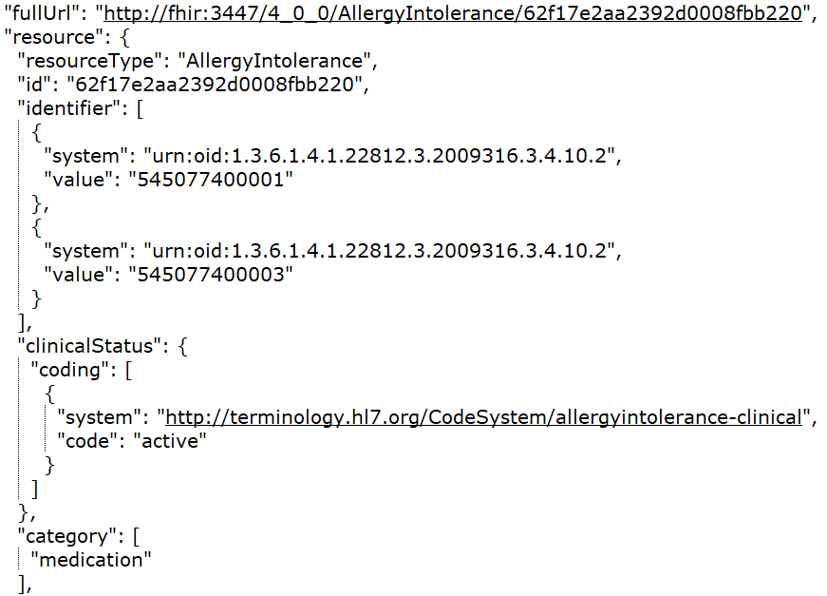
Cerner
DH
Google
MDIX
Redox
Rec in JSONC

Slide 4
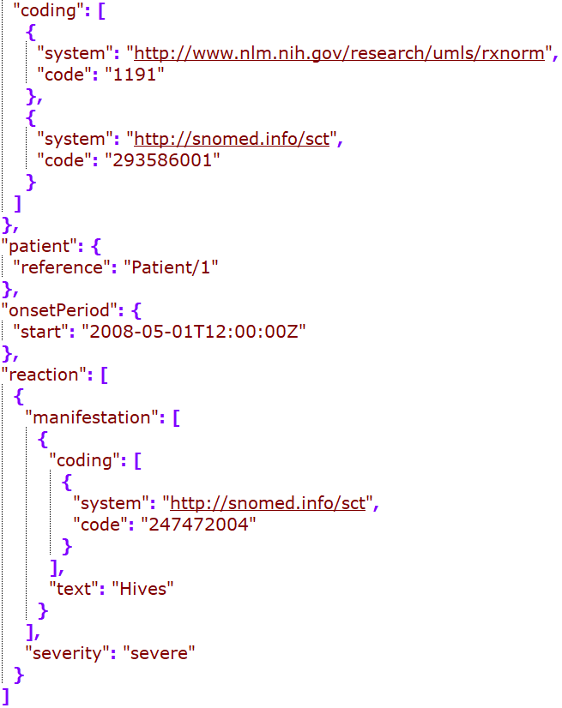
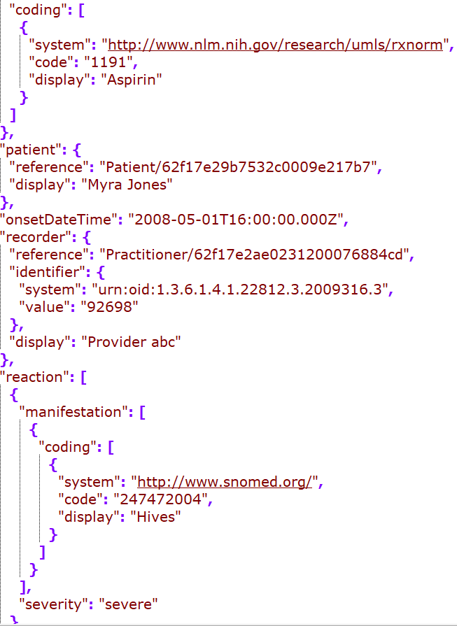
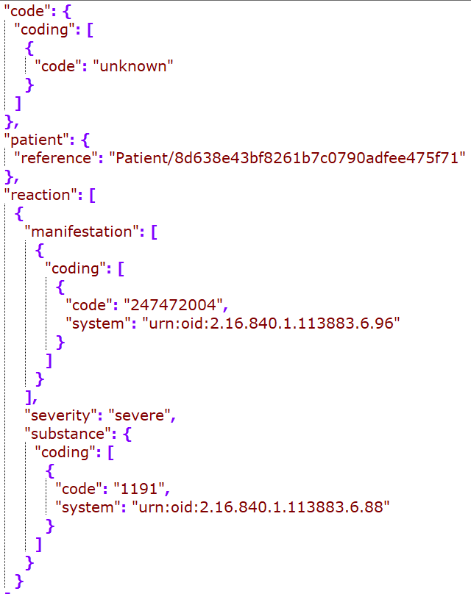
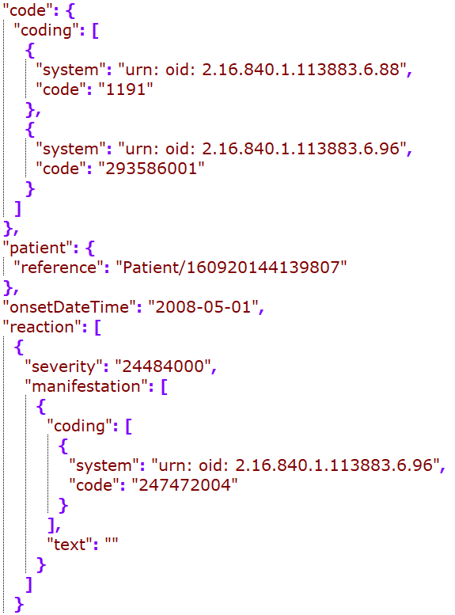
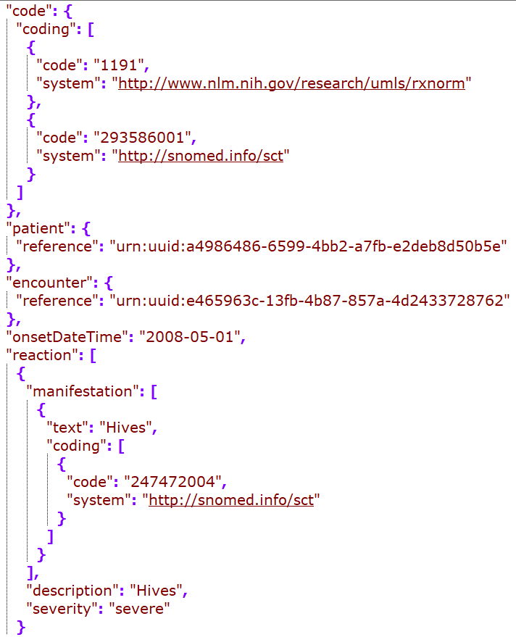
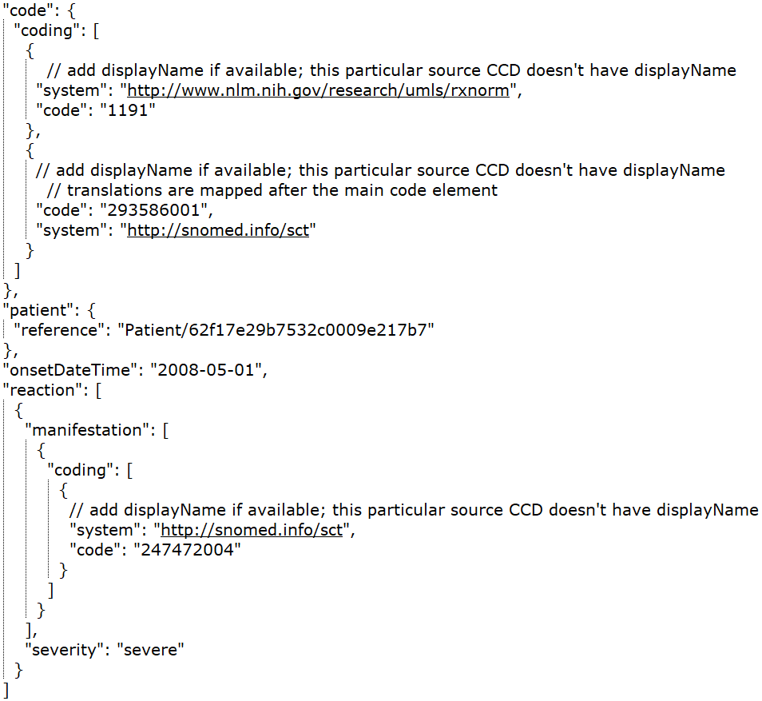
Cerner
DH
Google
MDIX
Redox
Rec – in JSONC

Slide 5
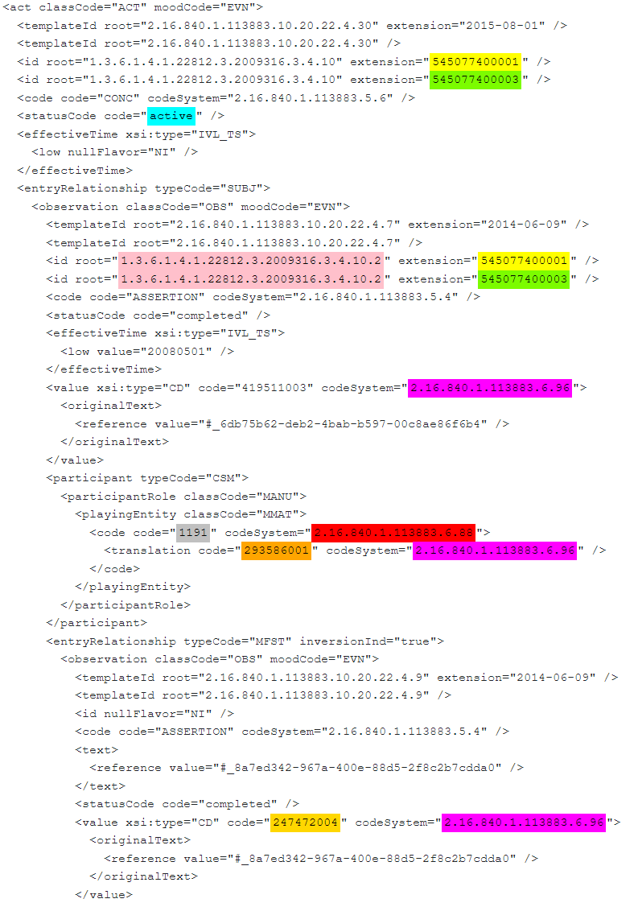
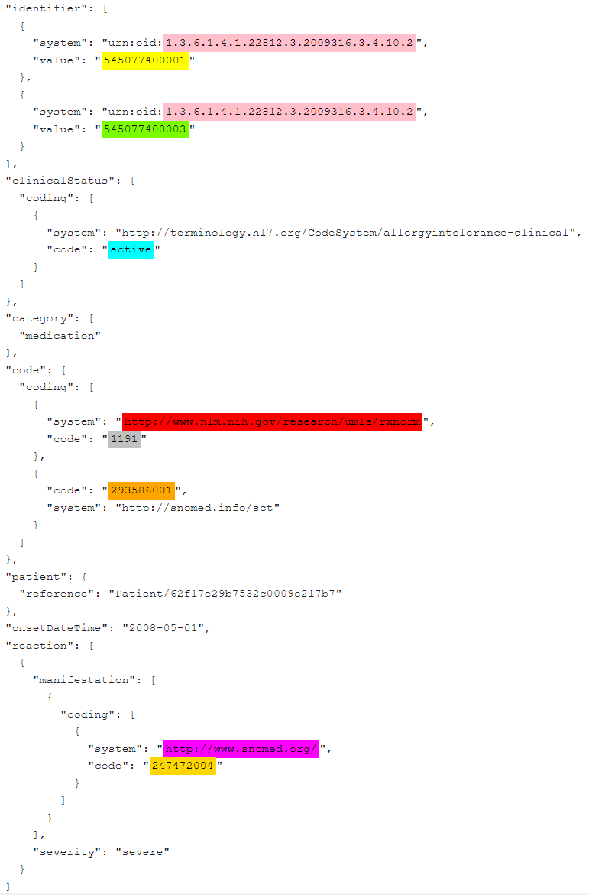
CCD – Allergy snippet
FHIR – Allergy snippet

Slide 6
Immunization

Slide 7
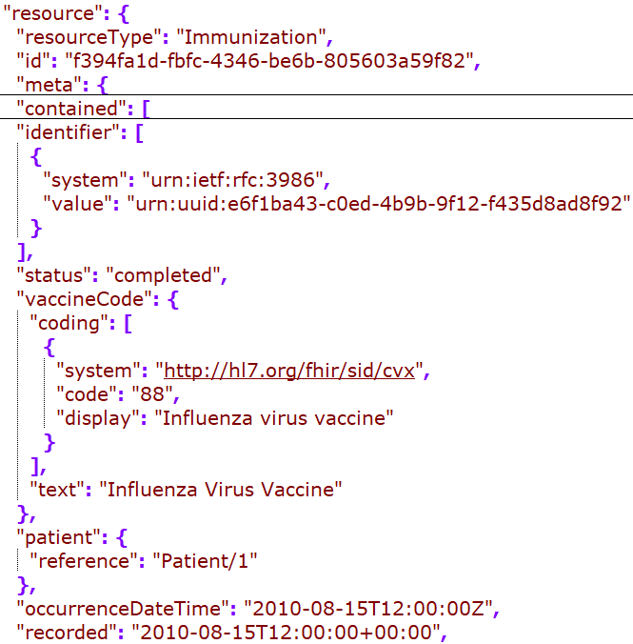
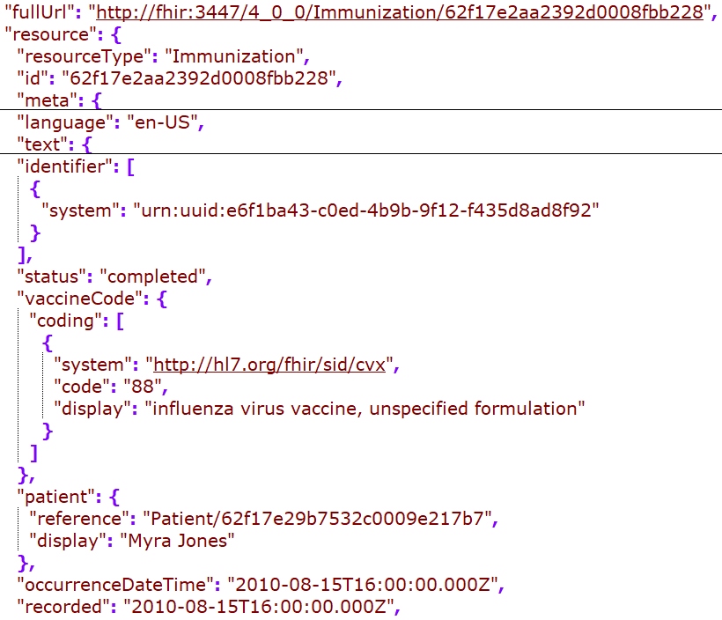
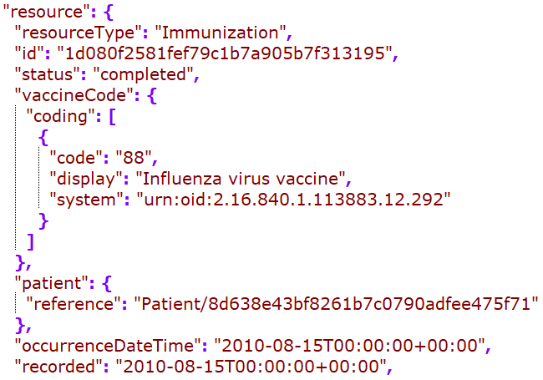
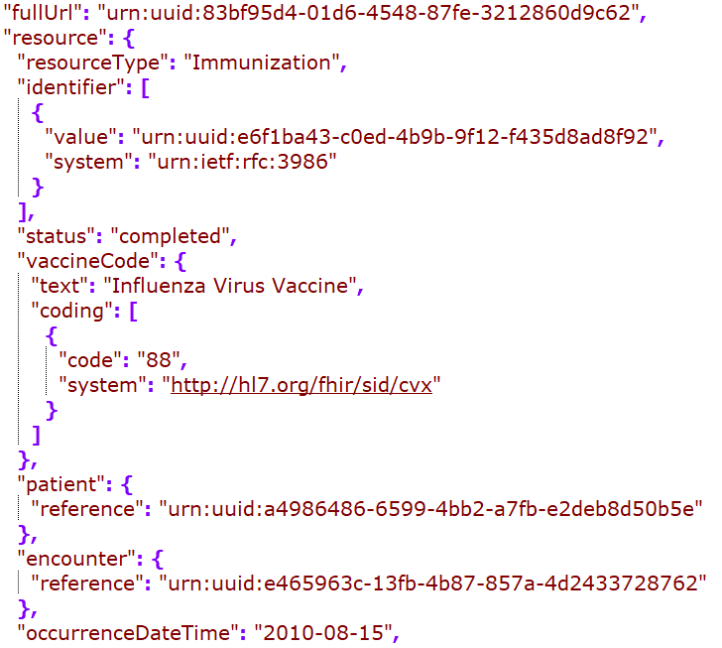
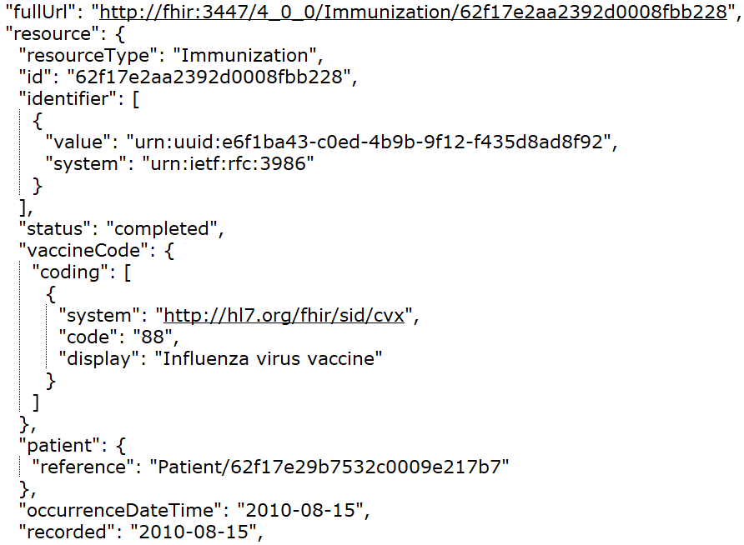
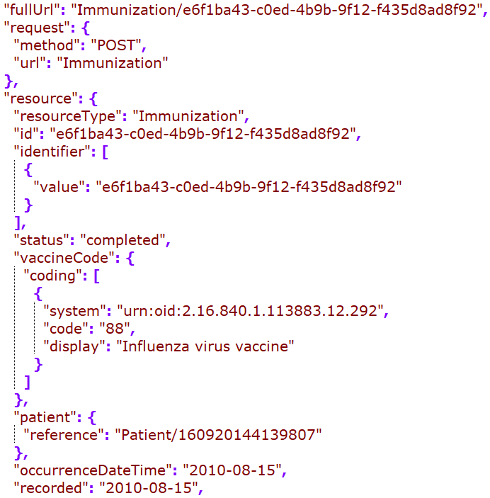
Cerner
DH
Google
MDIX
Redox
Rec – in JSONC

Slide 8
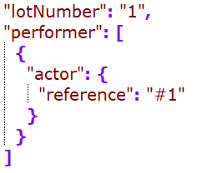
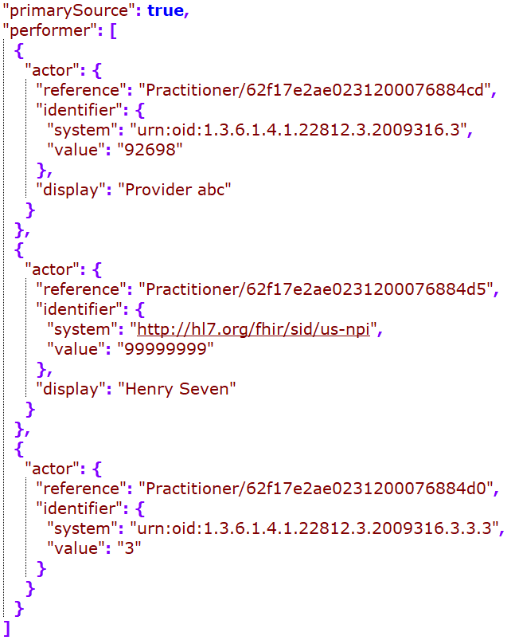
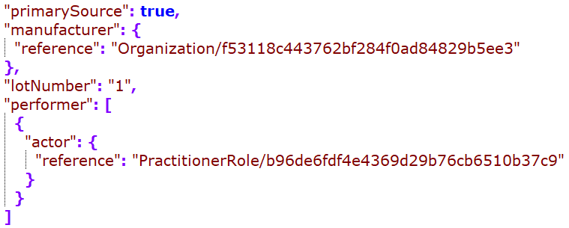
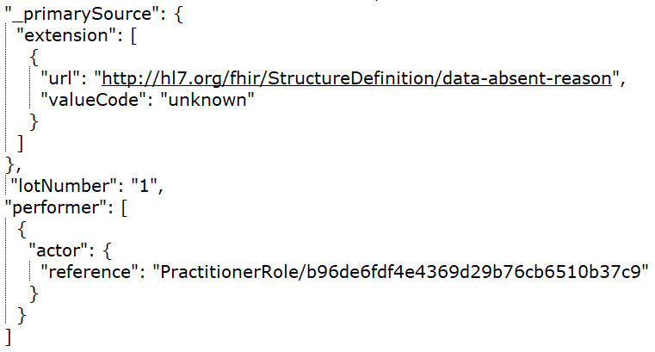
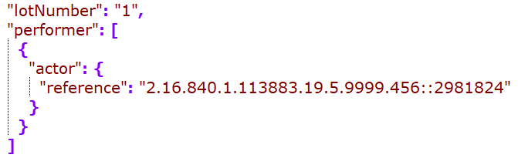
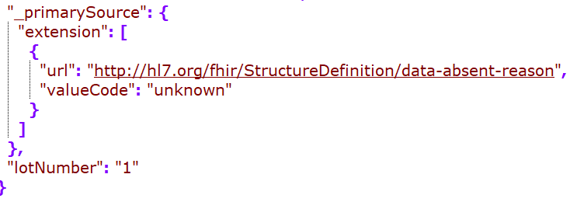
Cerner
DH
Google
Rec – in JSONC
MDIX
Redox

Slide 9
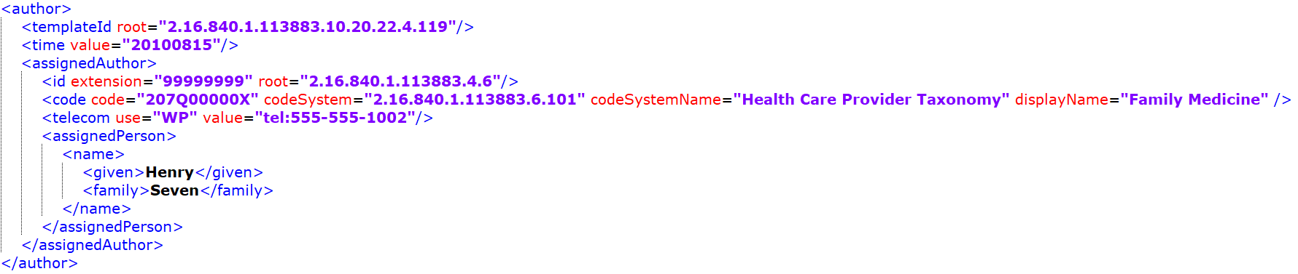
While performer is picked up by some, the author seems to be dropped from all mappings…
Since there is not “recorder” for the immunization resource, this could be mapped to provenance.

Slide 10
Patient

Slide 11
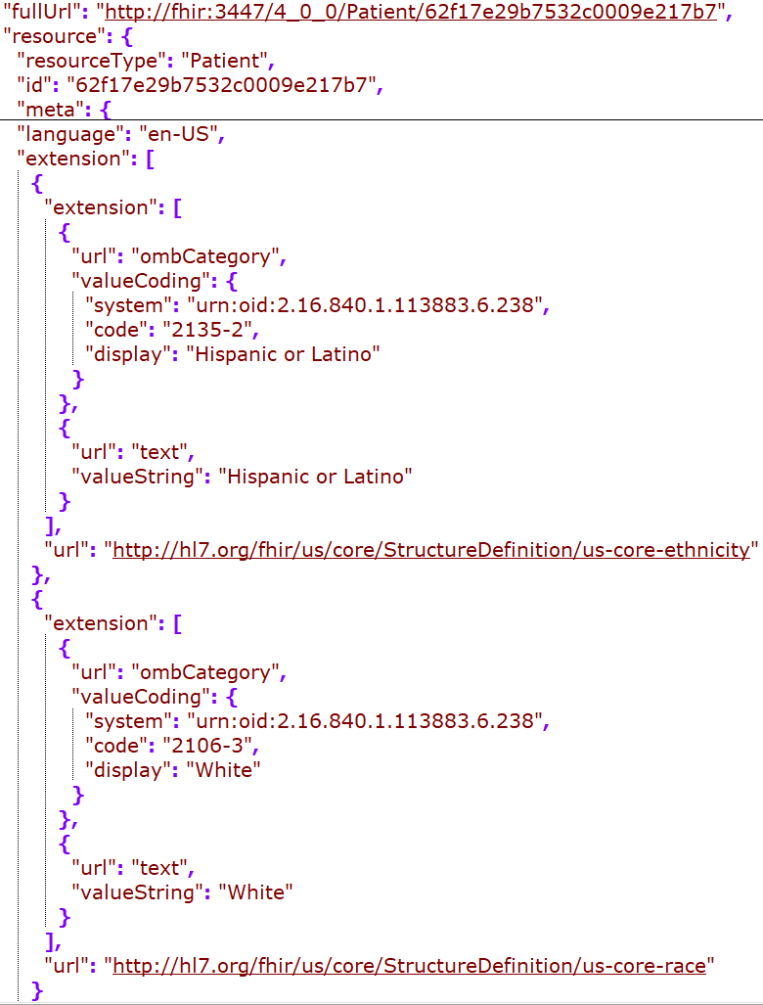
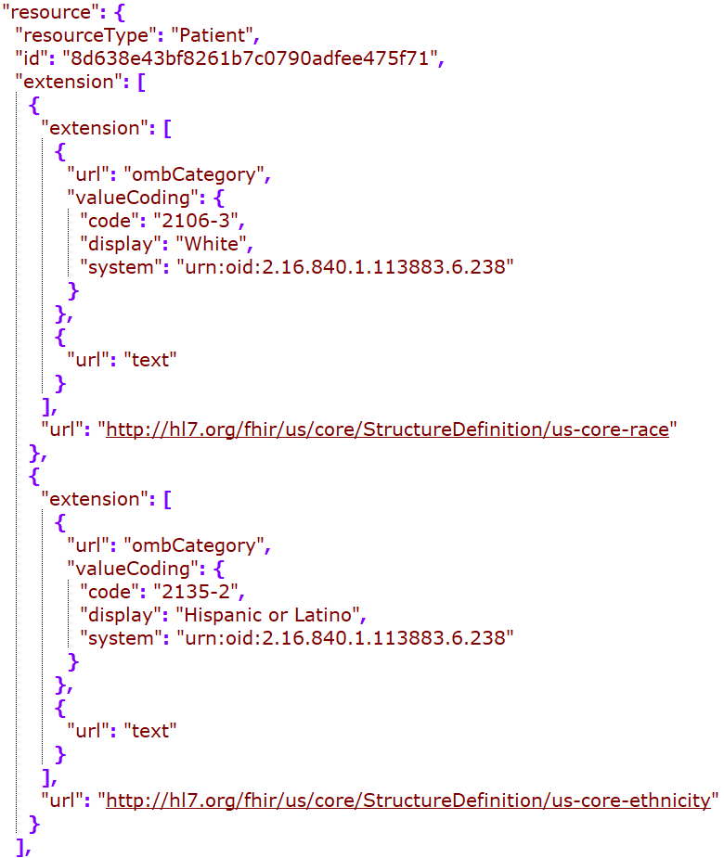
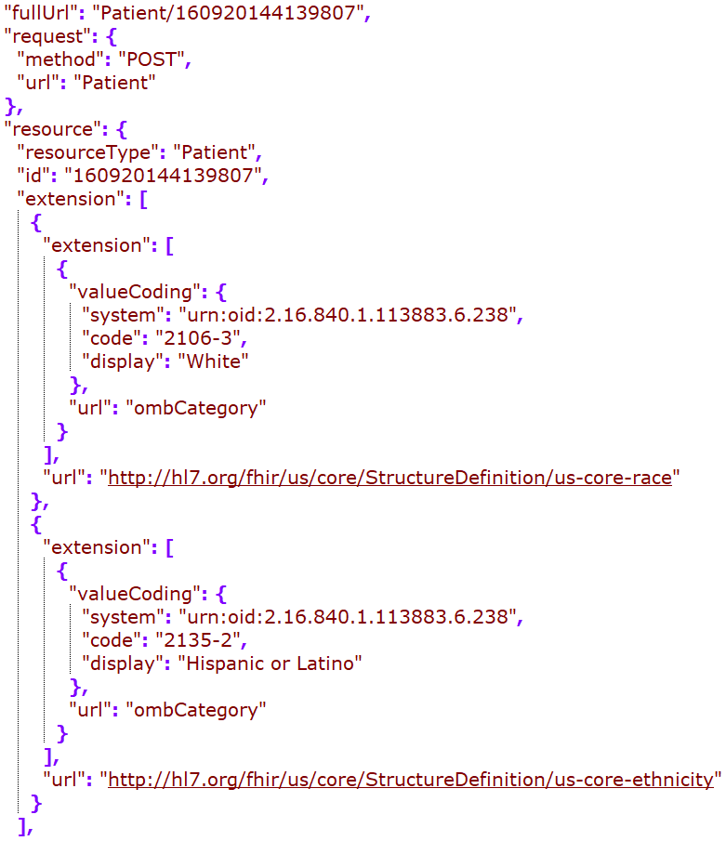
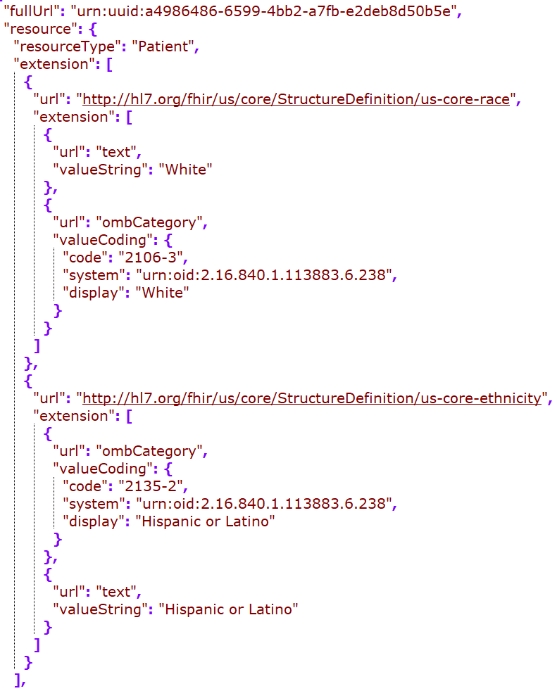
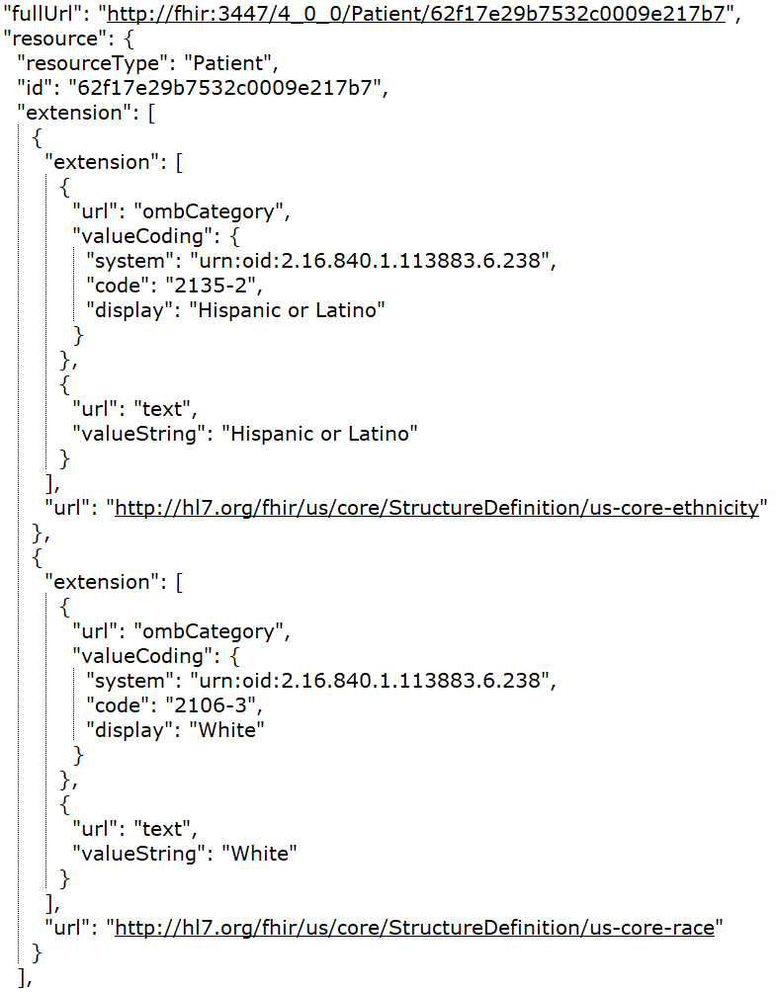
DH
Google
MDIX
Redox
Rec – in JSONC

Slide 12
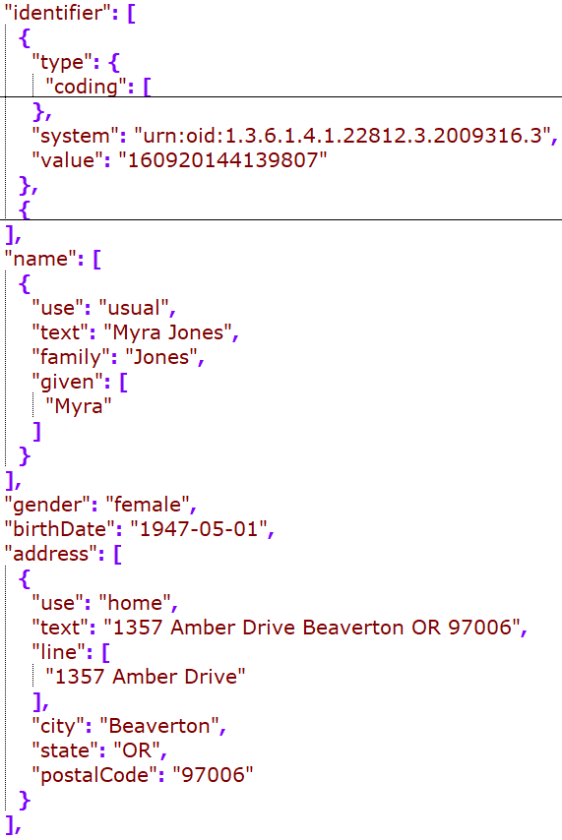
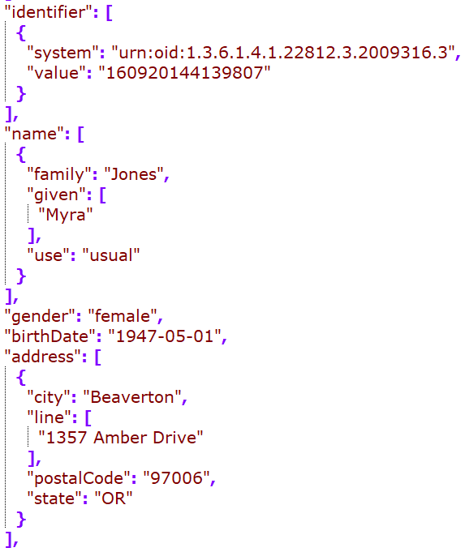
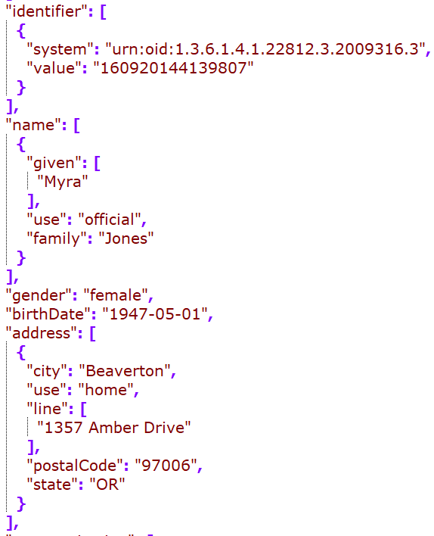
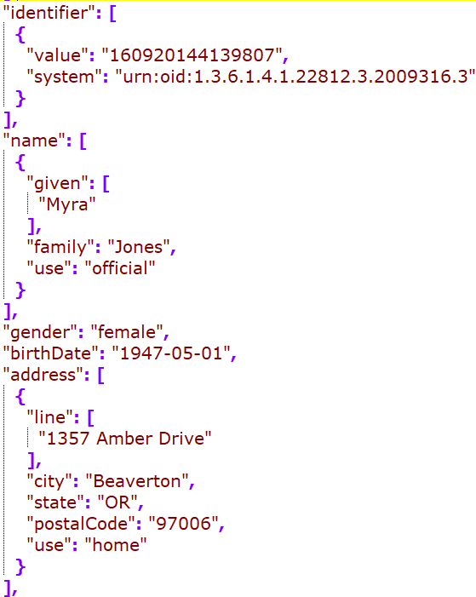
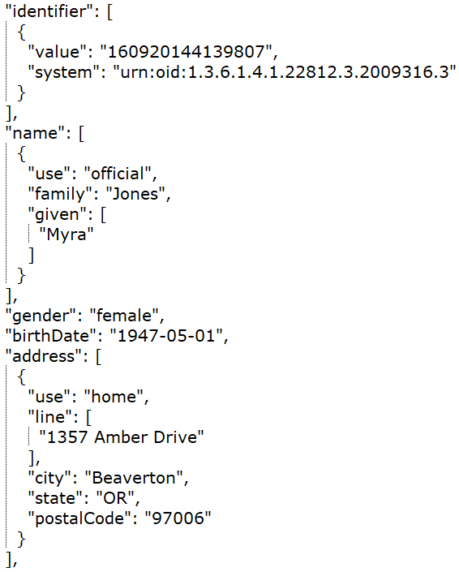
DH
Google
MDIX
Redox
Rec – in JSONC

Slide 13
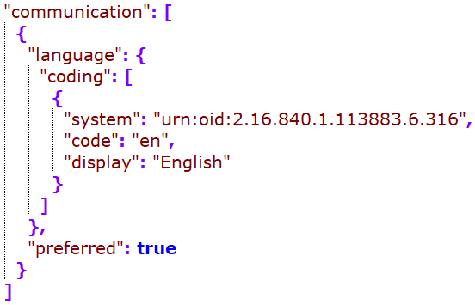
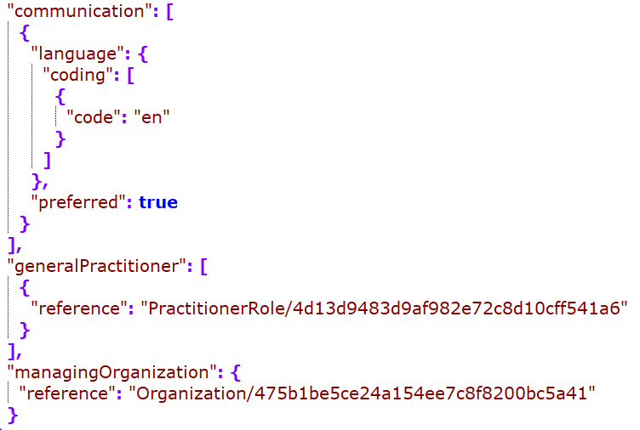
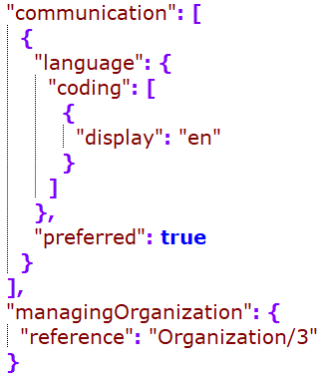
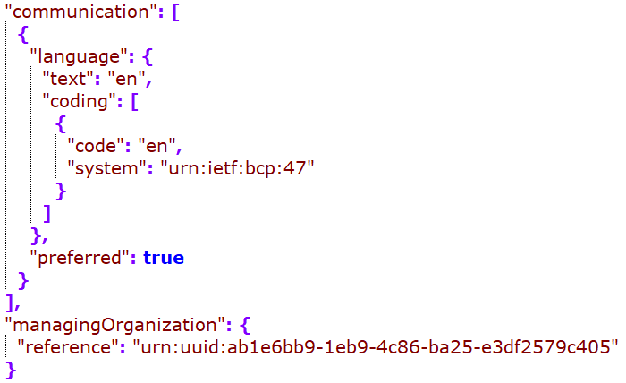
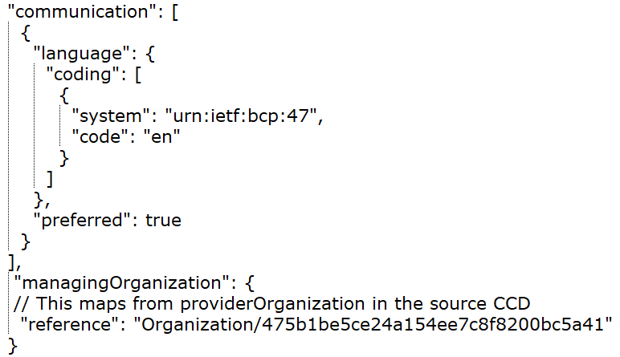
DH
Google
MDIX
Redox
Rec – in JSONC

Slide 14
Problem

Slide 15
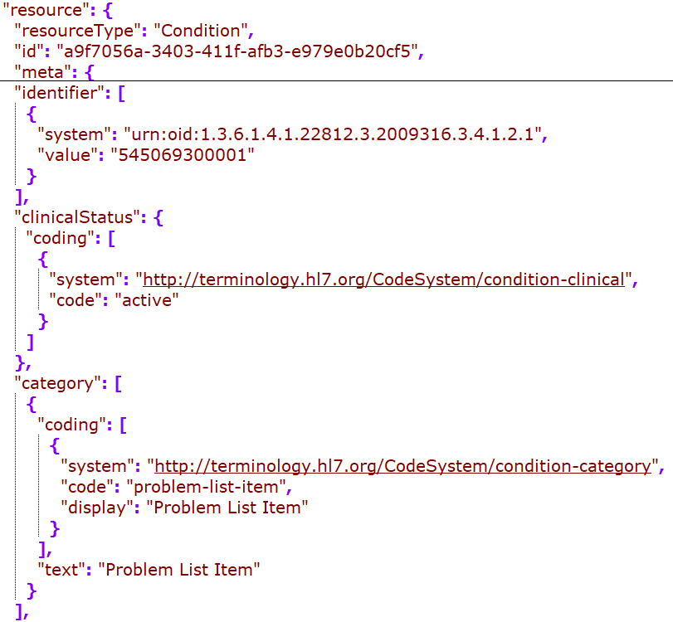
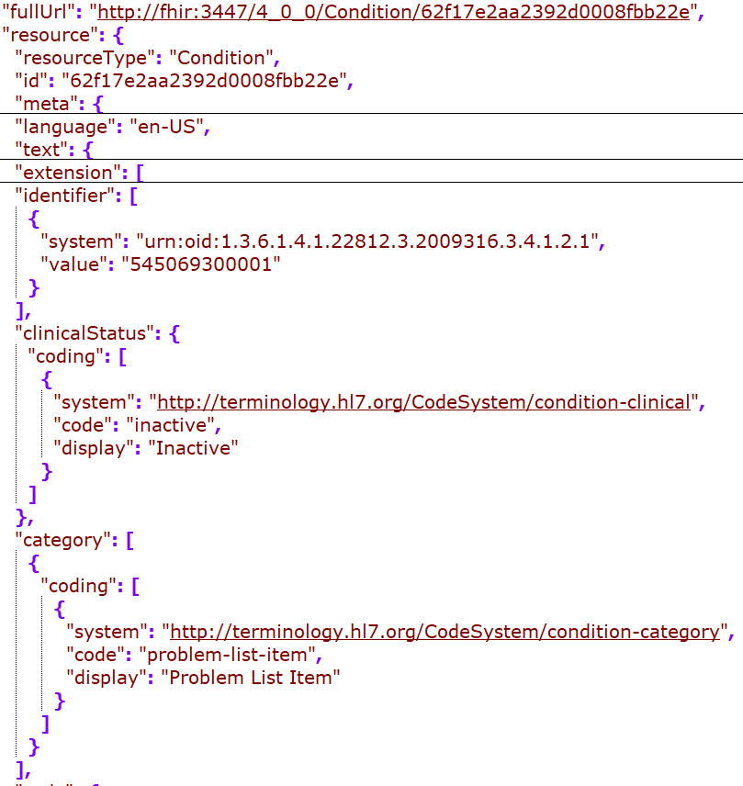
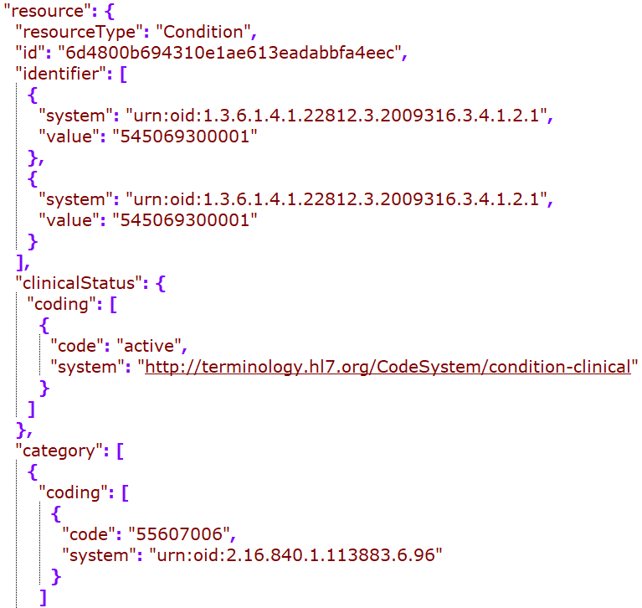
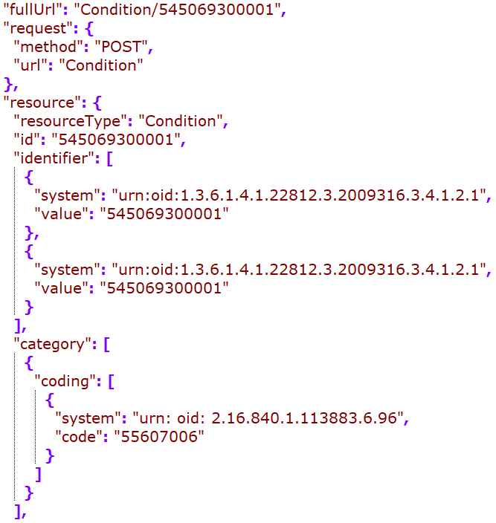
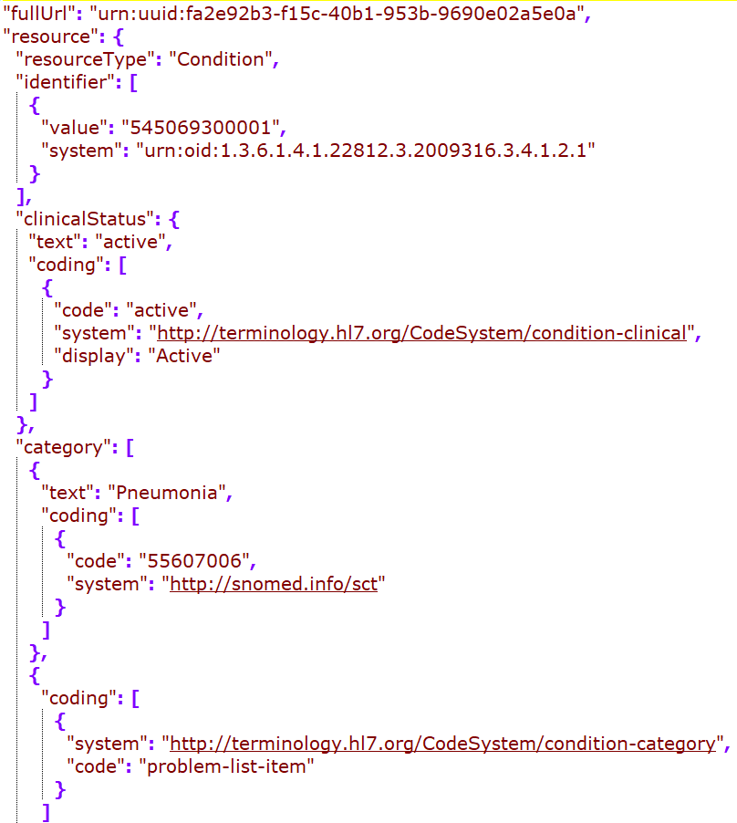
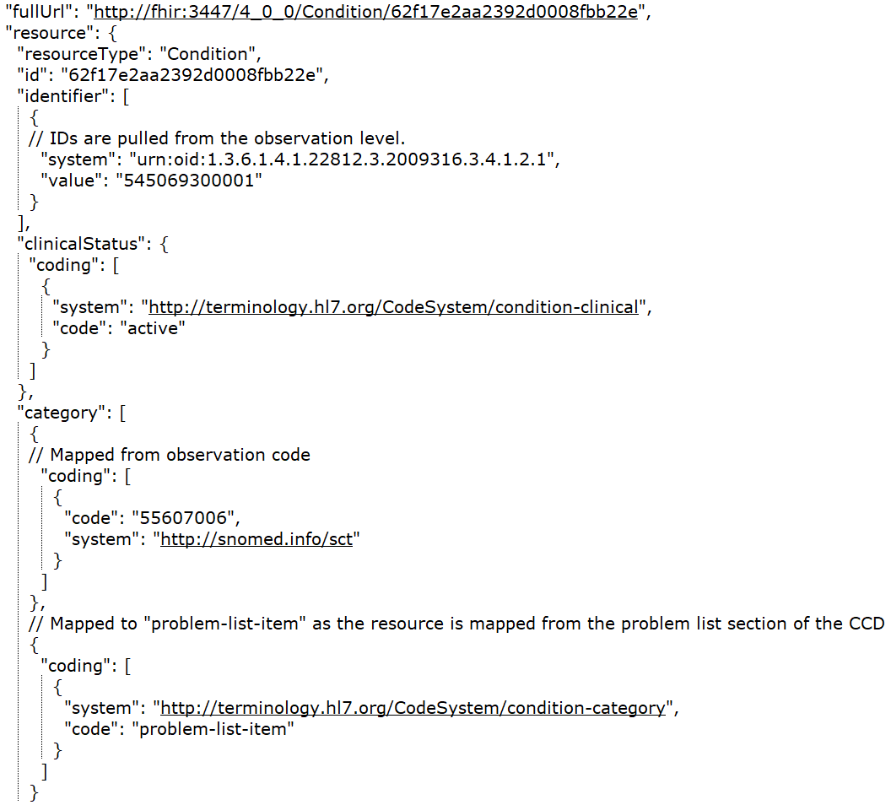
Cerner
DH
Google
Rec – in JSONC
MDIX
Redox
Notes:
Id dedupe?
Category including the actual code (a retired SNOMED code for problem), or problem-list-item (looks like this is required)

Slide 16
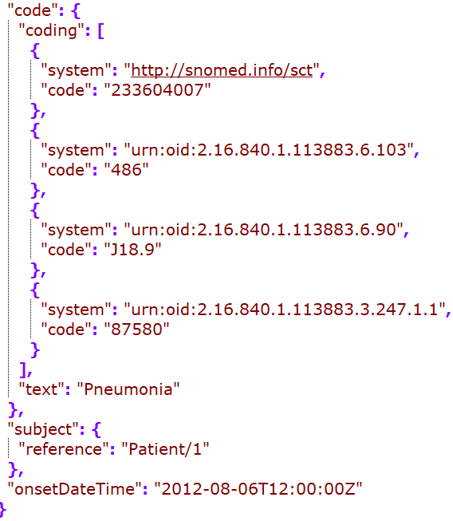
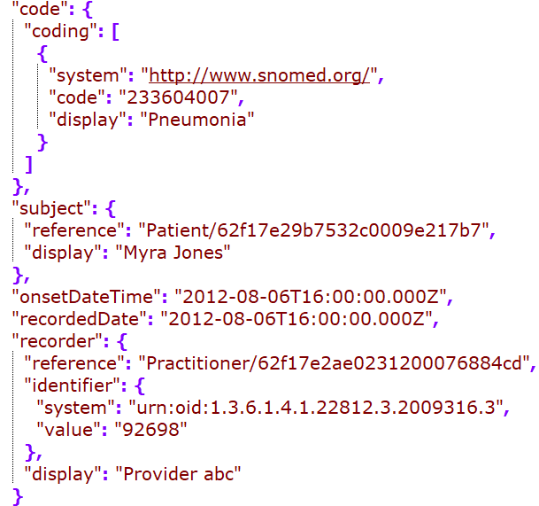




Cerner
DH
Google
MDIX
Redox
Rec – in JSONC
Notes:
Observation timestamp – mapped to onsetDateTime or onsetPeriod.start
Map the act timestamp?

Slide 17
Encounter Diagnosis

Slide 18




DH
MDIX
Rec – in JSONC
Redox
Notes:
Id mapping?
Identifier?
Should we have clinical status? Optional and not provided on the diagnosis ER

Slide 19




DH
MDIX
Rec – in JSONC
Redox
Notes:
Map the observation effectiveTime to onsetDAteTime?
How is the DH’s recordedDAte mapped?
MDIX’s evidence?

Slide 20
Medication -
Mapping to medicationRequest for all medication entries
May also map to other medication resources as needed, but the map is out of scope of this project

Slide 22
Procedure

Slide 23
Result

Slide 24
Vital Sign

Slide 25
Social History

